Slide 1

Lab 02 Lesson 04
Introduction to Flutter
TMA3084 Software Engineering Lab (G01)
Lab Demonstrator
Muhammad Irfan Nabyl bin Mohamad Yaakub (84712)
Lecturer
Ts Nurfauza binti Jali
TMA3084 (G01) 2025/2026-1

Slide 2
Table of Contents
Understanding Flutter
Flutter Framework
Android Studio
Flutter SDK
Installing and Configuring Flutter SDK
Creating a New Flutter Project
Setup an Android Virtual Device
Run a Flutter App
Installing Flutter on Mac
Test Your Flutter App on iOS Phone with Windows O.S
Android Studio Sugar and Spice
Run your Apps on a Hardware Device (Physical Phone)
Emulator Debug Mode
Introduction to Flutter Widgets
Creating a Flutter App Using Widgets
What is a MaterialApp widget?
Lab 4: Creating a Simple Flutter App
TMA3084 (G01) 2025/2026-1

Slide 3

Understanding Flutter (1/2)
Google’s SDK
Craft beautiful, fast user experiences for apps from a single codebase
Mobile apps development
  Objective-C, Swift, Java, Kotlin
  Published to Google Play or App Store
TMA3084 (G01) 2025/2026-1

Slide 4
Understanding Flutter (2/2) – Features
Beautiful UI
  Design without limitation
  High multimedia control
  UI toolkit with widgets
Fast Results
  Uses open source 2D graphics – Skia
  Powered by Dart – enable compiling into mobile application, web, and desktop devices
Productive Development
  Hot reload – Change code and view result in real time
Extensible and Open Model
  Works with many development tools
    Visual Studio Code, IntelliJ, Android Studio
TMA3084 (G01) 2025/2026-1

Slide 5
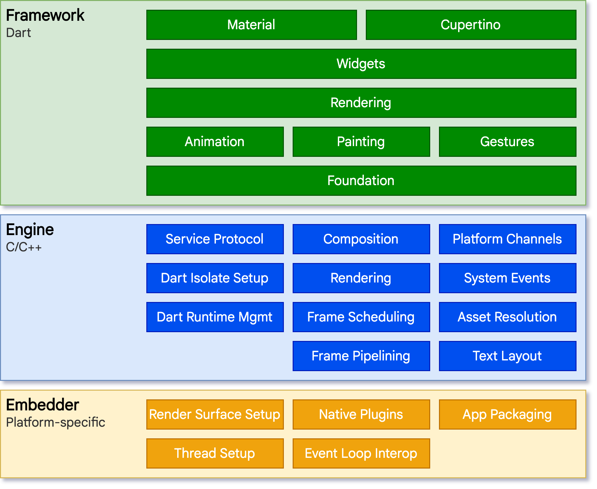
Flutter Framework
Organised into a series of layers
  Framework – most frequently used than other layers
Do more with less code
Use readily available or create custom widgets
Focus more on framework layer
TMA3084 (G01) 2025/2026-1

Slide 6
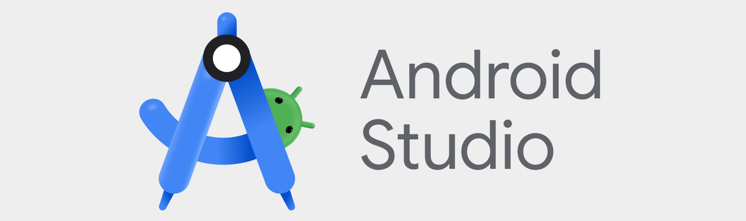
Android Studio
Official IDE for Android app development based on IntelliJ IDEA
TMA3084 (G01) 2025/2026-1

Slide 7
Flutter SDK
-
TMA3084 (G01) 2025/2026-1

Slide 8
Installing and Configuring Flutter SDK
-
TMA3084 (G01) 2025/2026-1

Slide 9
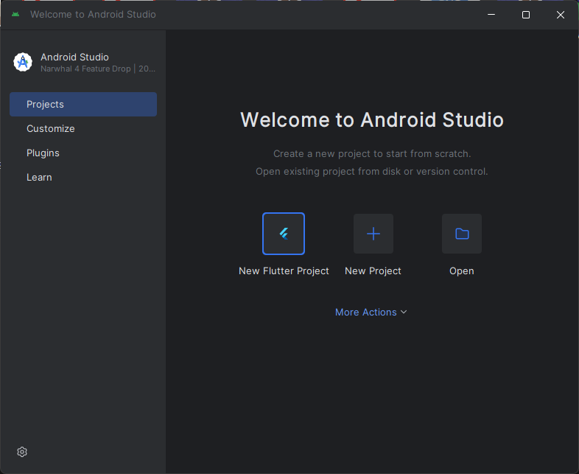
Creating a New Flutter Project (1/4)
Lab 4: Creating a Simple Flutter App
Open Android Studio
From sidebar – Click “Projects”
Click “New Flutter Project”
1
2
TMA3084 (G01) 2025/2026-1

Slide 10
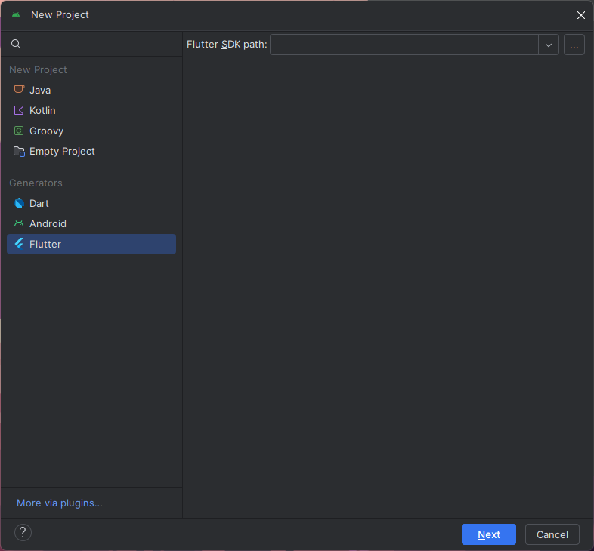
Creating a New Flutter Project (2/4)
Lab 4: Creating a Simple Flutter App
From sidebar – Click “Flutter” from “Generators” section
Click “…”, find, and select “flutter” folder
  Default (type in address bar): %USERPROFILE%/develop
Click “Next”
TMA3084 (G01) 2025/2026-1

Slide 11
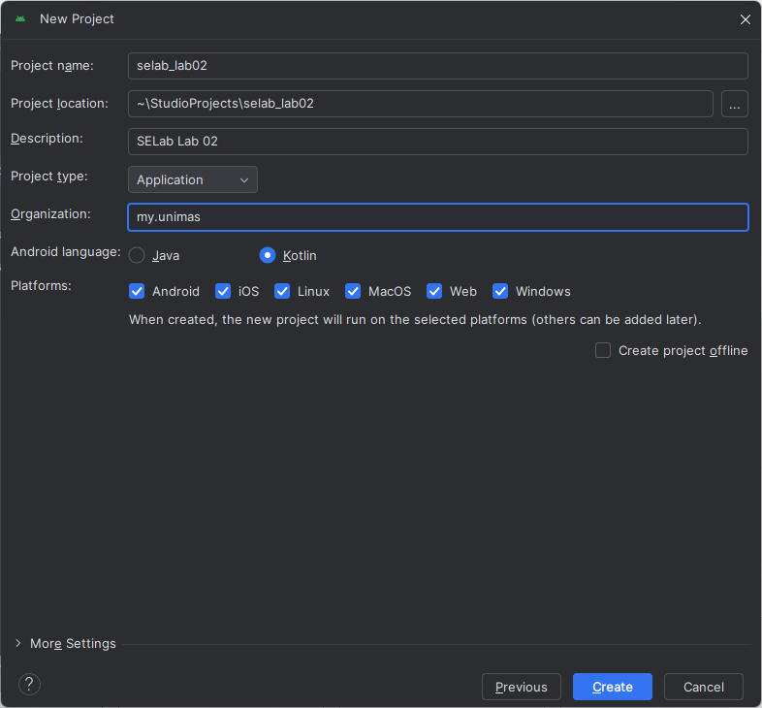
Creating a New Flutter Project (3/4)
Lab 4: Creating a Simple Flutter App
Project name: any (e.g. selab_lab02)
Project location: any
Description: any (e.g. SELab Lab 02)
Project type: Application
Organisation: reversed domain name (e.g. my.unimas)
Android language: Kotlin
Platforms: any
Click “Create”
TMA3084 (G01) 2025/2026-1

Slide 12
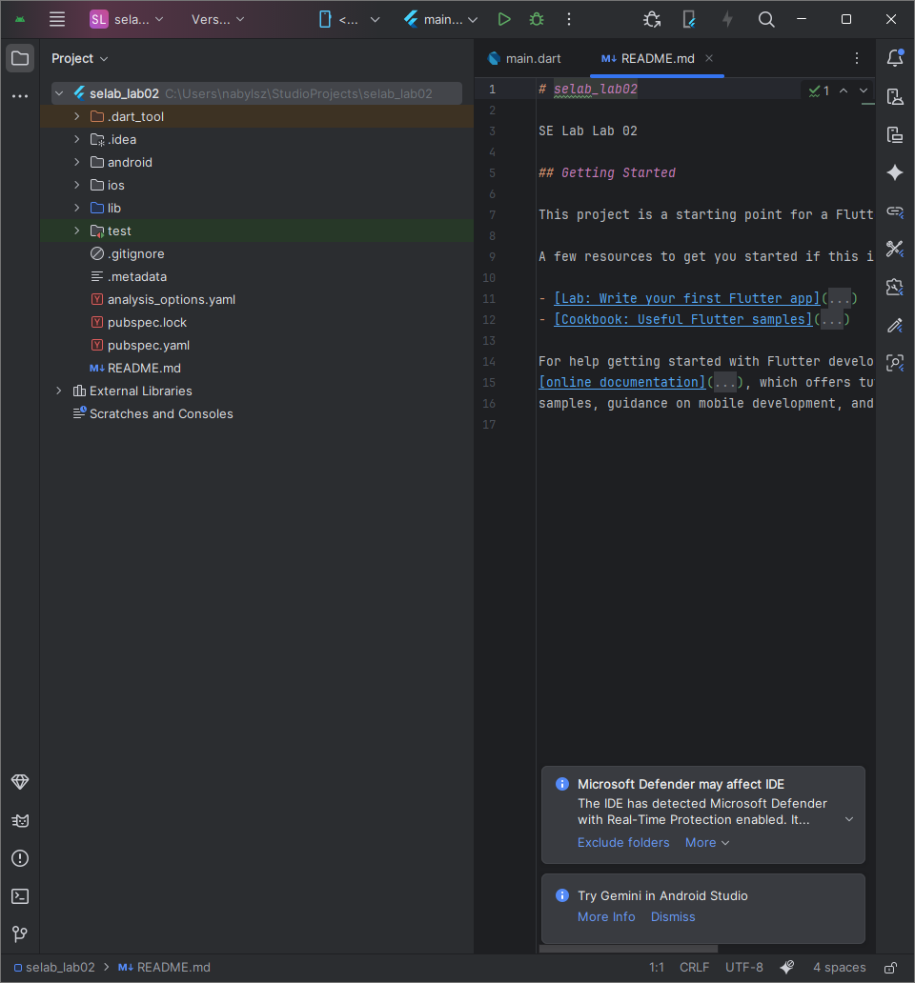
Creating a New Flutter Project (4/4)
Lab 4: Creating a Simple Flutter App
Microsoft Defender may affect IDE – Press “Exclude folders”
Done🏁
TMA3084 (G01) 2025/2026-1

Slide 13
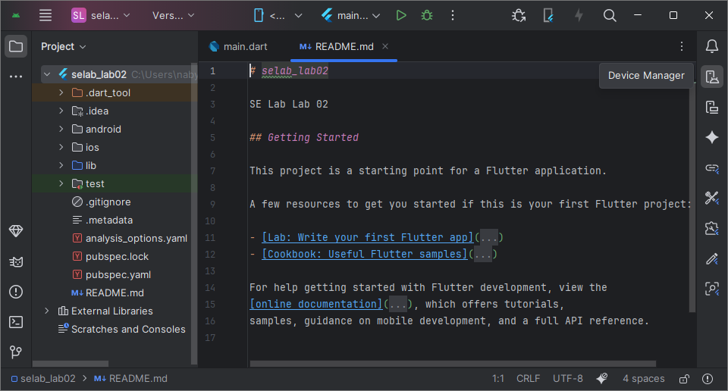
Setup an Android Virtual Device (1/8)
From right sidebar – Click “Device Manager”
TMA3084 (G01) 2025/2026-1

Slide 14
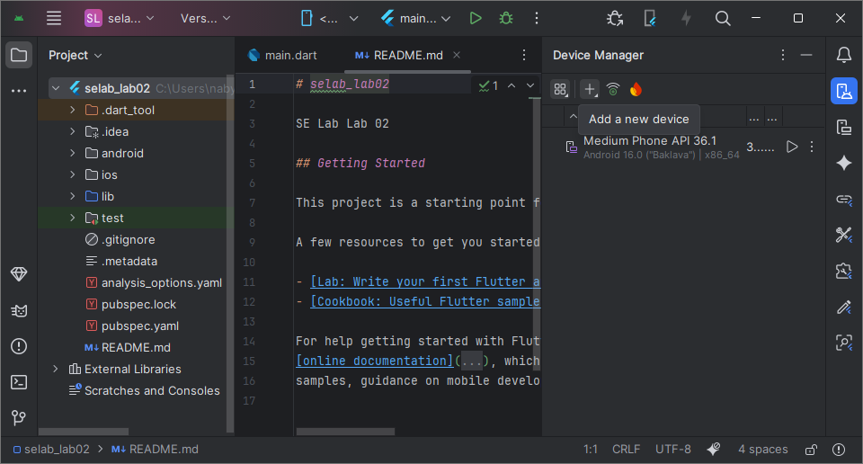
Setup an Android Virtual Device (2/8)
Click “+ (Add a New Device)”, then click “Create Virtual Device”
Skip to step 6 if have a device
TMA3084 (G01) 2025/2026-1

Slide 15
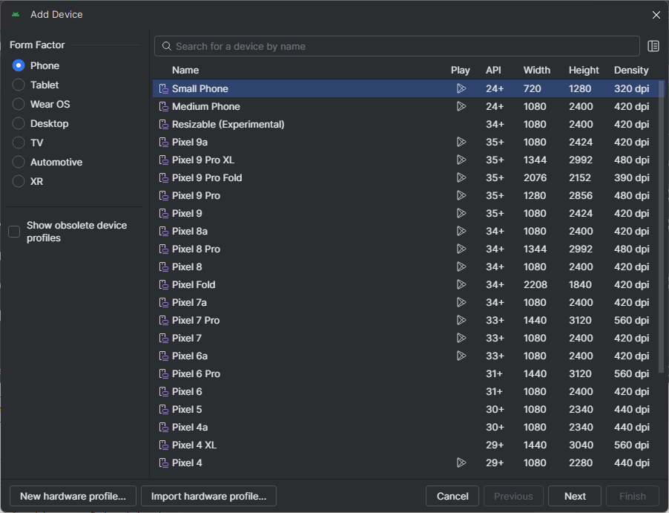
Setup an Android Virtual Device (3/8)
Select preferred device (e.g. Small Phone), then click “Next”
TMA3084 (G01) 2025/2026-1

Slide 16
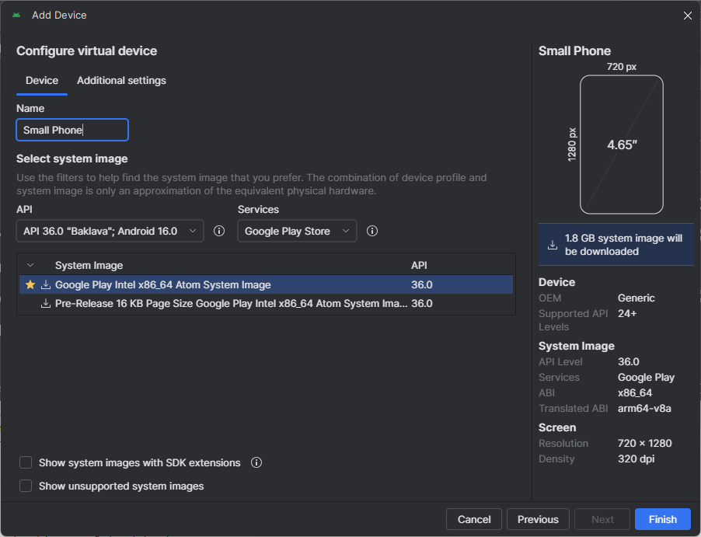
Setup an Android Virtual Device (4/8)
Customise “Device” and “Additional settings”, then Click “Finish”
TMA3084 (G01) 2025/2026-1

Slide 17
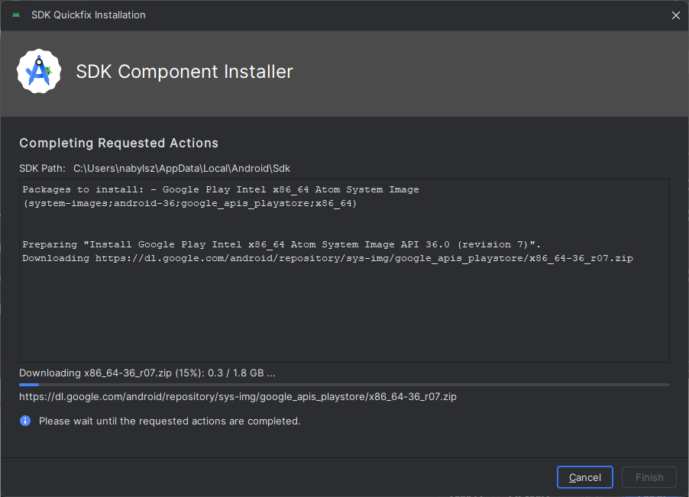
Setup an Android Virtual Device (5/8)
Accept download and wait until finish
TMA3084 (G01) 2025/2026-1

Slide 18
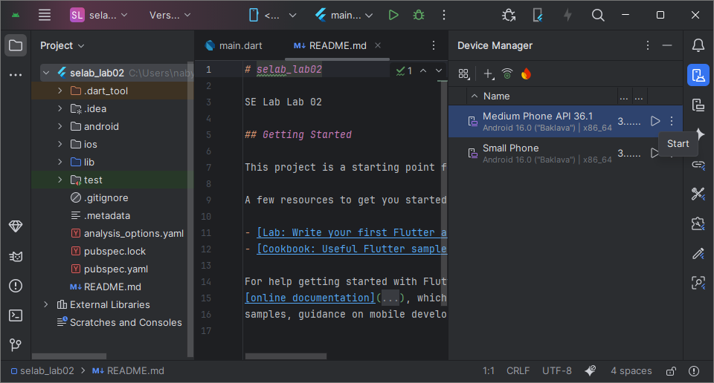
Setup an Android Virtual Device (6/8)
Press “▶️ (Start)” and be patient
TMA3084 (G01) 2025/2026-1

Slide 19
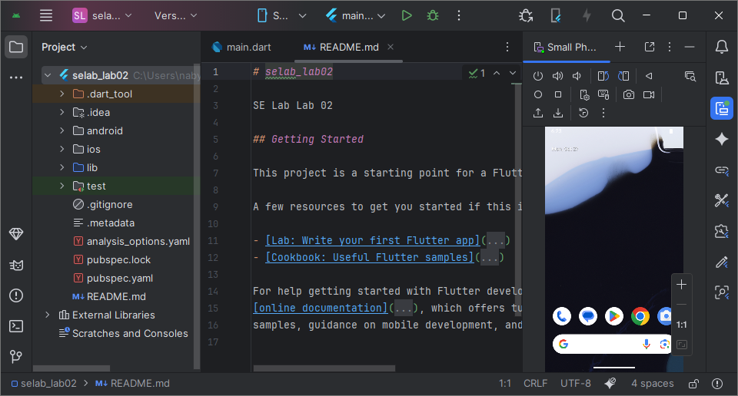
Setup an Android Virtual Device (7/8)
Done🏁
TMA3084 (G01) 2025/2026-1

Slide 20
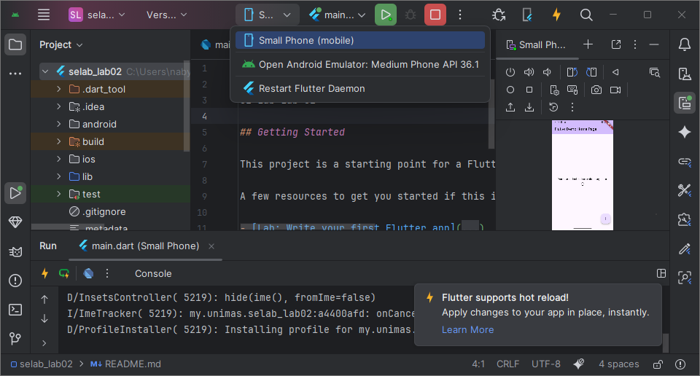
Setup an Android Virtual Device (8/8)
From top bar – Click on “📱” and select activated emulator device or “Restart Flutter Daemon” if not found
TMA3084 (G01) 2025/2026-1

Slide 21
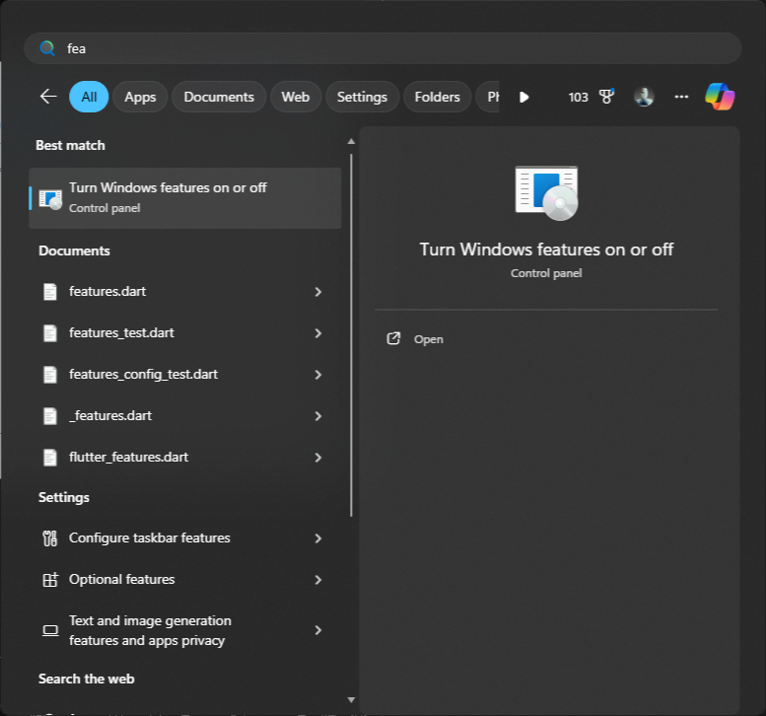
Enable Hardware Virtualisation (1/4)
Open Start Menu (⊞ Win), type to search “features” and click on “Turn Windows features on or off”
1
2
TMA3084 (G01) 2025/2026-1

Slide 22
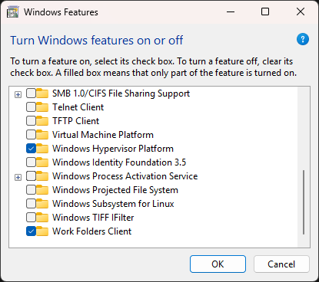
Enable Hardware Virtualisation (2/4)
Scroll down, then tick on “Windows Hypervisor Platform”
  AMD Ryzen processor – untick on Hyper-V (if visible)
Restart computer
  Ready to enter BIOS – Spam “F2”, “F10”, or “Del” button once computer lights are visible or has noise
1
2
TMA3084 (G01) 2025/2026-1

Slide 23
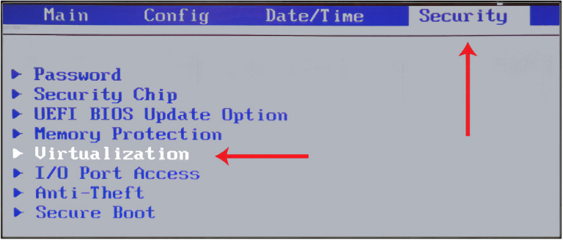
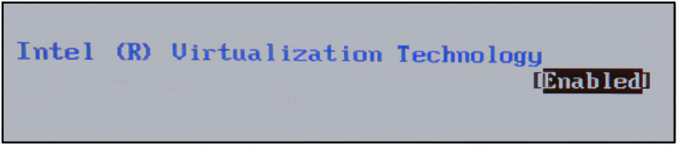
Enable Hardware Virtualisation (3/4)
Intel processor – Go to “Security” tab, then “Virtualization”
Intel (R) Virtualization Technology – Set to “Enable”
Save and exit from BIOS
P.S. Setting steps may be varying from different computer model and BIOS
TMA3084 (G01) 2025/2026-1

Slide 24
Enable Hardware Virtualisation (4/4)
AMD processor – Go to “MIT” tab, then enter “Advanced Frequency Settings”
Enter “Advanced CPU Core Settings”
“SVM Mode” – Set to “Enabled”
Save and exit from BIOS
P.S. Setting steps may be varying from different computer model and BIOS
TMA3084 (G01) 2025/2026-1

Slide 25
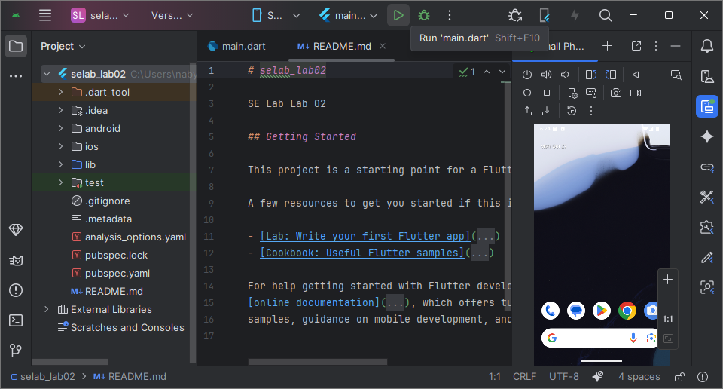
Run a Flutter App (1/2)
From top bar – Press “▶️ (Run ‘main.dart’)” or press SHIFT + F10
TMA3084 (G01) 2025/2026-1

Slide 26
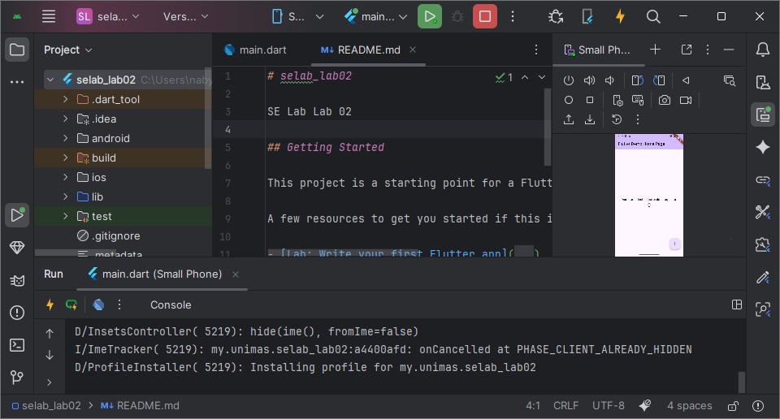
Run a Flutter App (2/2)
From top bar – Press “▶️ (Run ‘main.dart’)” or press SHIFT + F10
TMA3084 (G01) 2025/2026-1

Slide 27
Run a Flutter App – Hot reload
Change the following:
  Line 66
    _counter++;
      _counter+=3;
  Line 118
    child: const Icon(Icons.add),
      child: const Icon(Icons.favorite),
      child: const Icon(Icons.battery_charging_full),
      child: const Icon(Icons.call),
  Save project (CTRL + S) on each change
TMA3084 (G01) 2025/2026-1

Slide 28
Installing Flutter on Mac
-
TMA3084 (G01) 2025/2026-1

Slide 29
Test Your Flutter App on iOS Phone with Windows O.S
-
TMA3084 (G01) 2025/2026-1

Slide 30
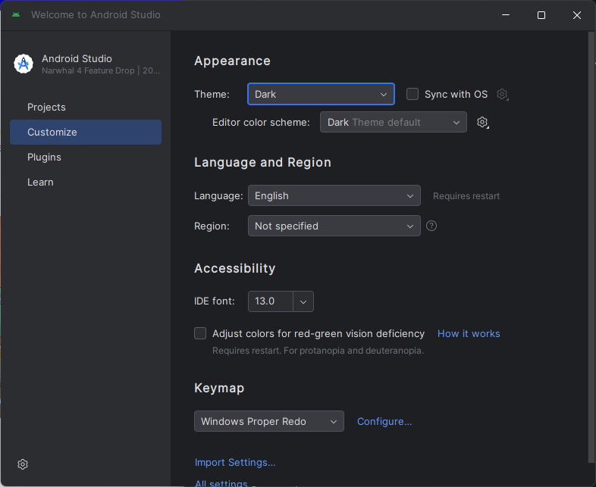
Android Studio Sugar and Spice (1/2)
Customize – Appearance
TMA3084 (G01) 2025/2026-1

Slide 31
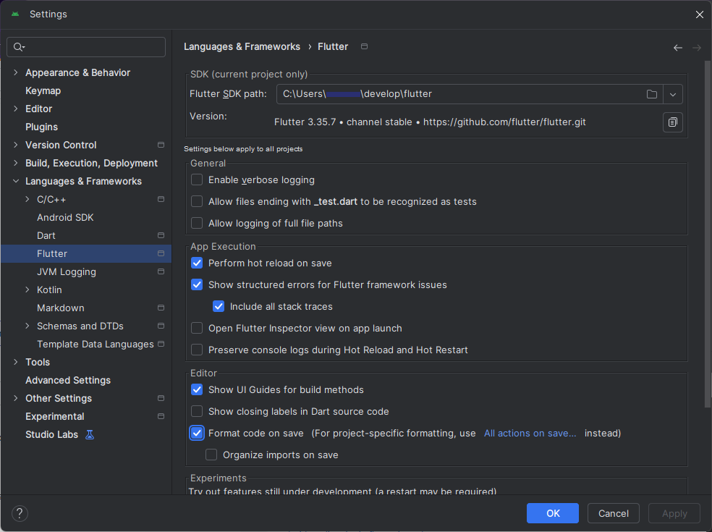
Android Studio Sugar and Spice (2/2)
Customize – Language & Framework → Flutter
  Open Flutter project first
Tick on
  Perform hot reload on save
  Format code on save
TMA3084 (G01) 2025/2026-1

Slide 32
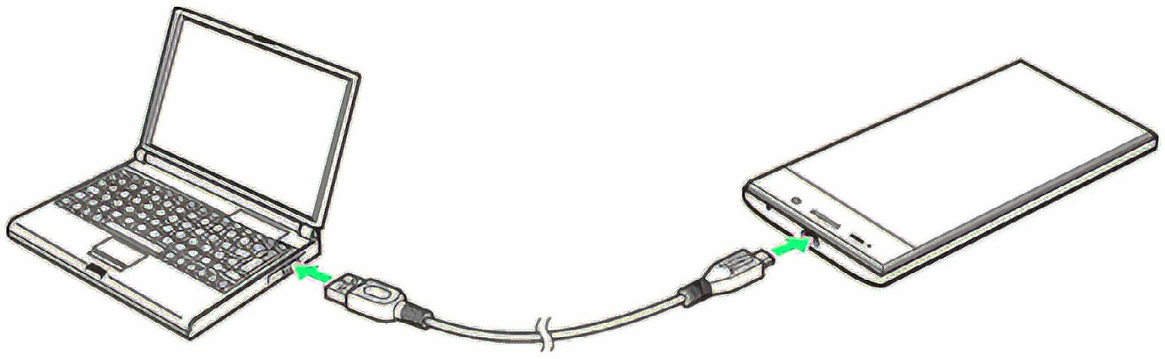
Run your Apps on a Hardware Device (Physical Phone) (1/7)
Connect smartphone to computer with data transfer-supported USB cable
TMA3084 (G01) 2025/2026-1

Slide 33
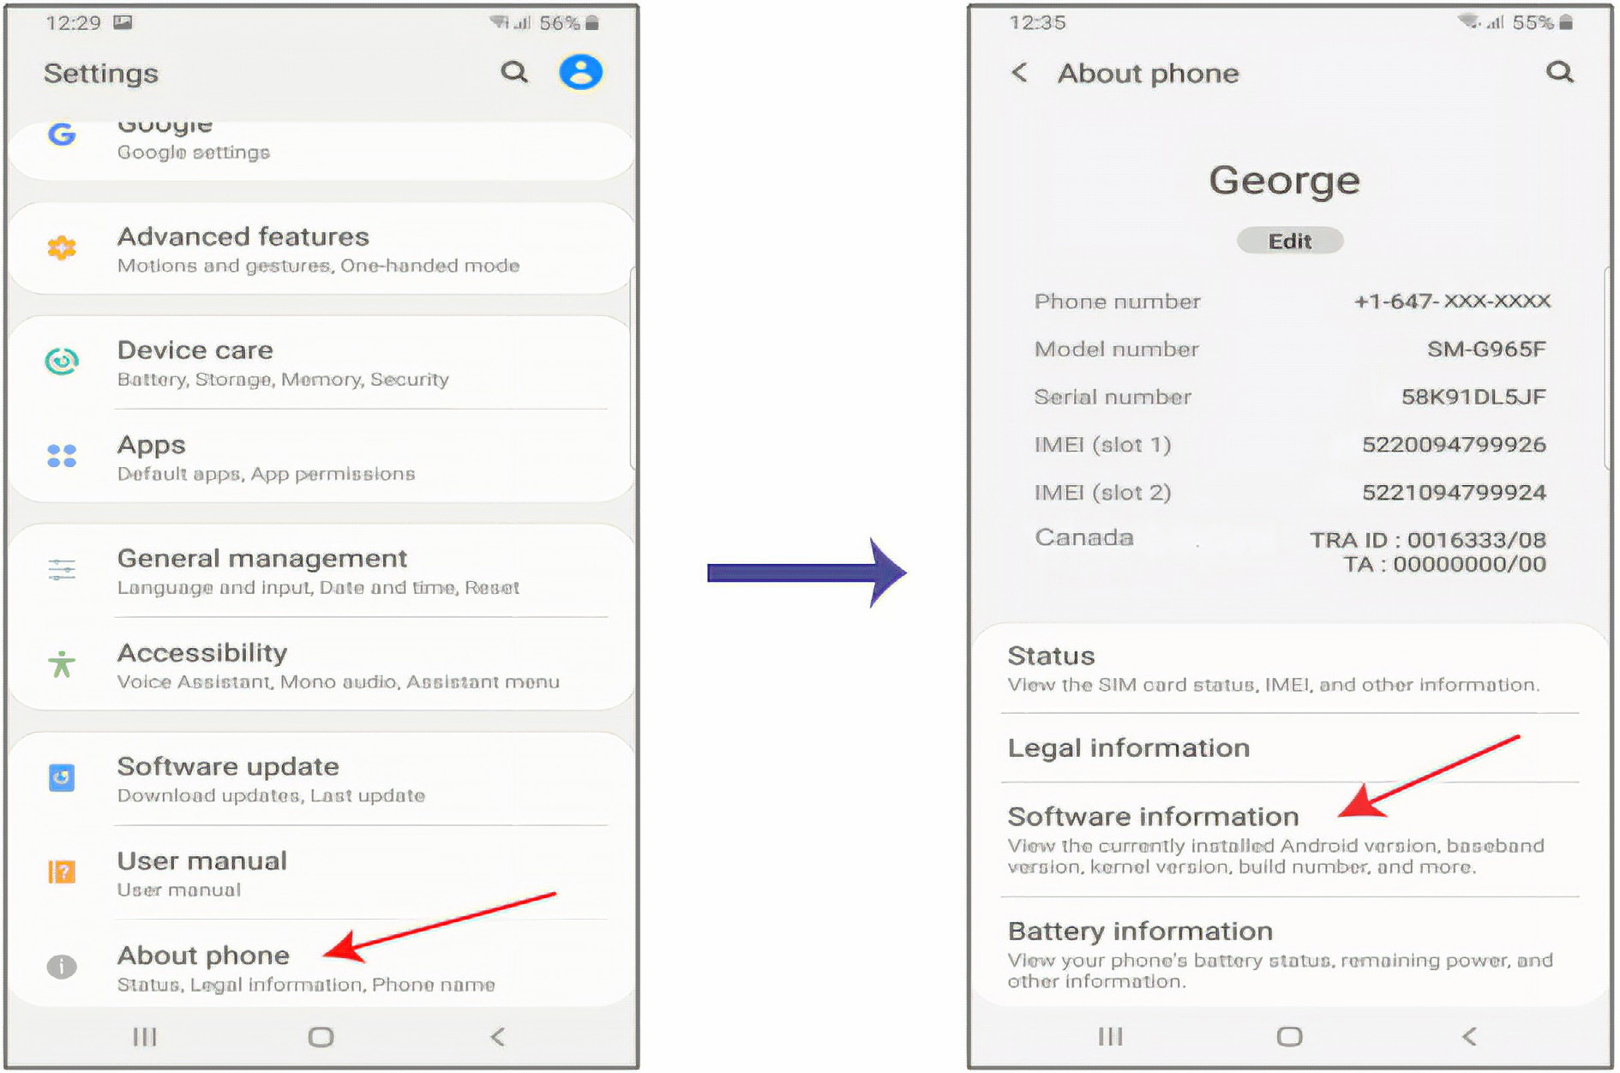
Run your Apps on a Hardware Device (Physical Phone) (2/7)
From smartphone, go to “Settings” → “About phone” → “Software information”
TMA3084 (G01) 2025/2026-1

Slide 34
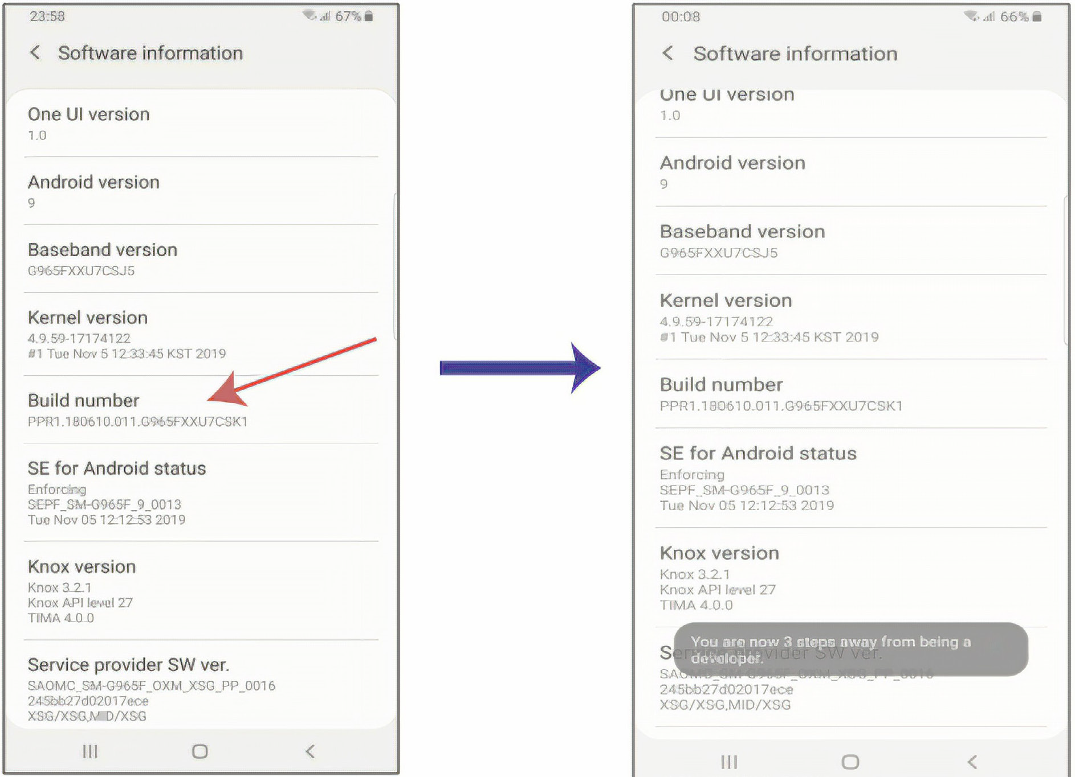
Run your Apps on a Hardware Device (Physical Phone) (3/7)
Tap “Build number” 7 times until “Developer mode has been turned on” message appears
TMA3084 (G01) 2025/2026-1

Slide 35
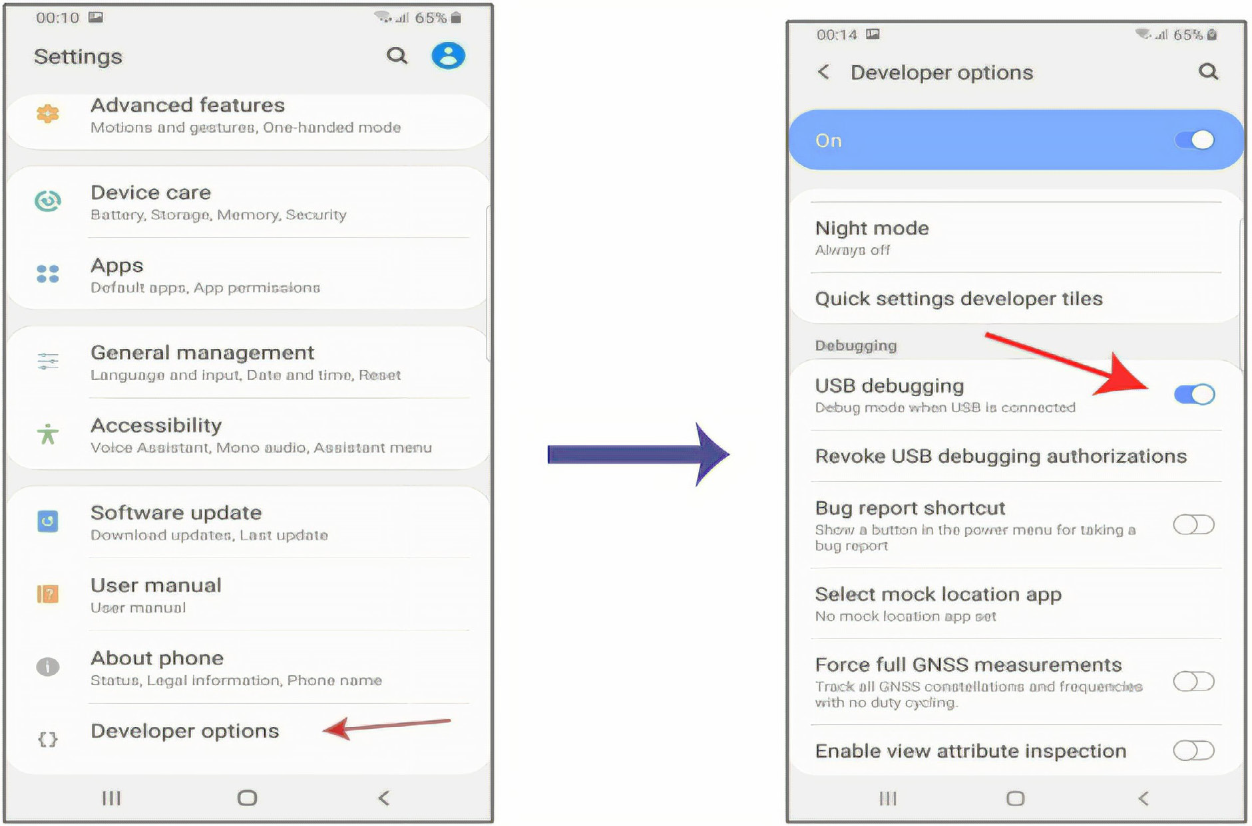
Run your Apps on a Hardware Device (Physical Phone) (4/7)
Go to “Settings” → “Developer options” – Set to “On” → “USB debugging” – Set to “On”
TMA3084 (G01) 2025/2026-1

Slide 36
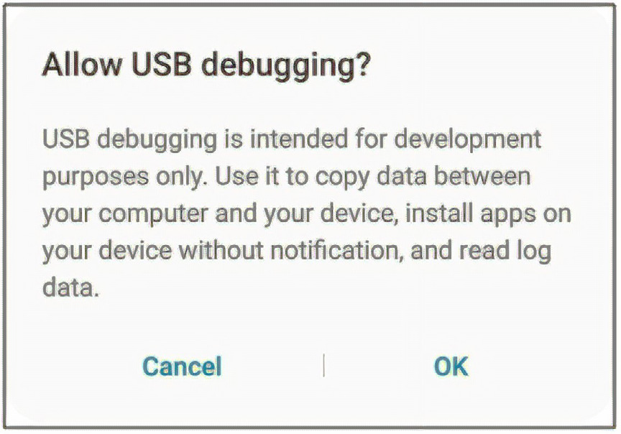
Run your Apps on a Hardware Device (Physical Phone) (5/7)
“Allow USB debugging?” → Tap “OK”
TMA3084 (G01) 2025/2026-1

Slide 37
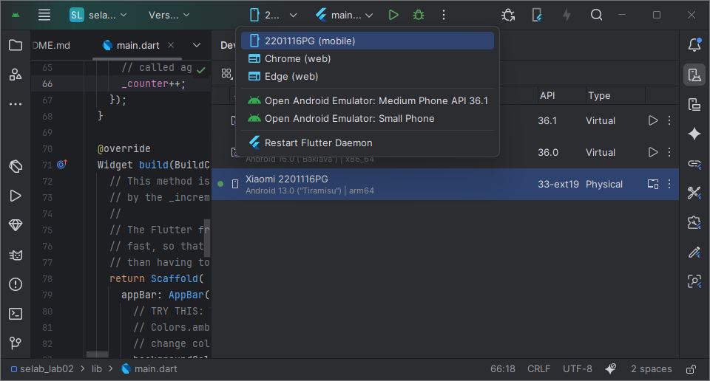
Run your Apps on a Hardware Device (Physical Phone) (6/7)
From Android Studio and top bar – Select smartphone, then run
TMA3084 (G01) 2025/2026-1

Slide 38
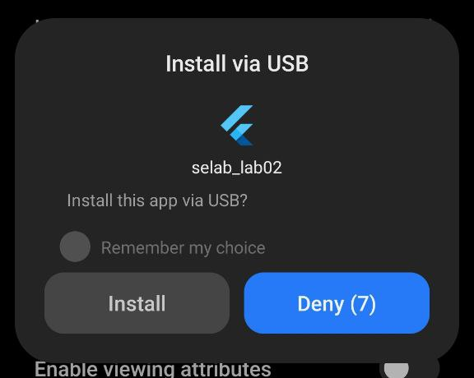
Run your Apps on a Hardware Device (Physical Phone) (7/7)
From smartphone – Tap “Install”
TMA3084 (G01) 2025/2026-1

Slide 39
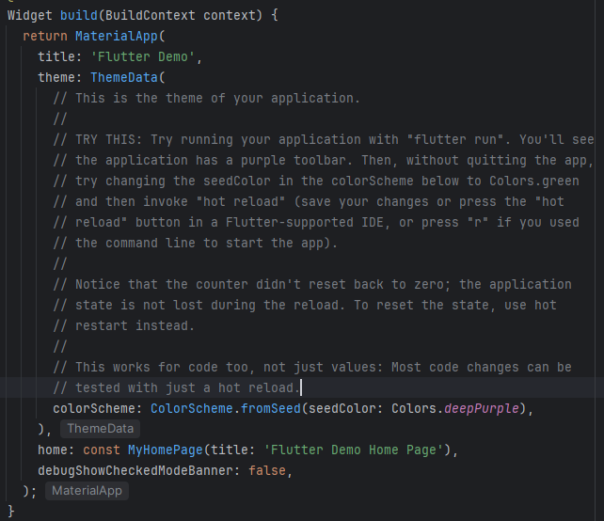
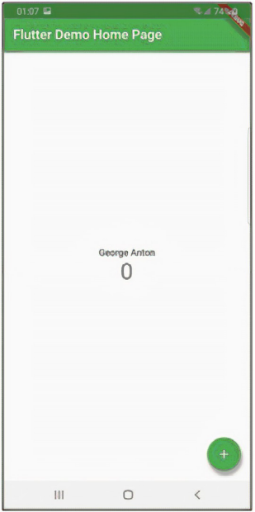
Emulator Debug Mode
“Debug” mode title banner – Not the final version of the app
Removed on building on real deveice
To remove:
  Add debugShowCheckedModeBanner: false,
TMA3084 (G01) 2025/2026-1

Slide 40
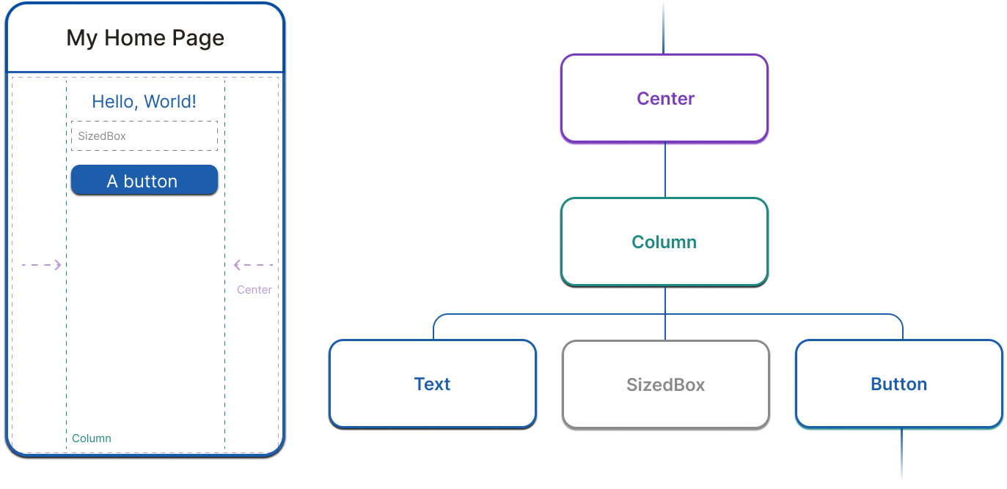
Introduction to Flutter Widgets (1/2)
Basic building blocks of a Flutter user interface
  images, icons, texts, menus, buttons, row, column
Combine existing widgets to make more sophisticated widgets
  e.g. Add three rows inside a column and add an image inside
TMA3084 (G01) 2025/2026-1

Slide 41
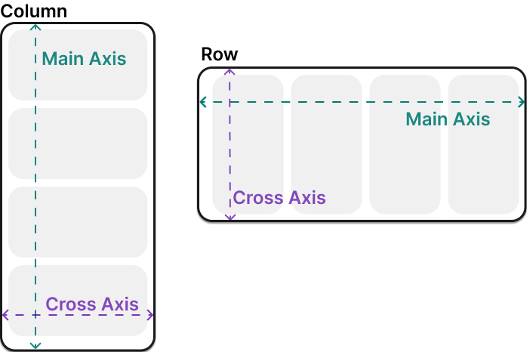
Introduction to Flutter Widgets (2/2)
Row and Column - Classes contain and layout widgets
  Parent – Row and Column widgets
  Childred – Widgets inside Row and Column
TMA3084 (G01) 2025/2026-1

Slide 42
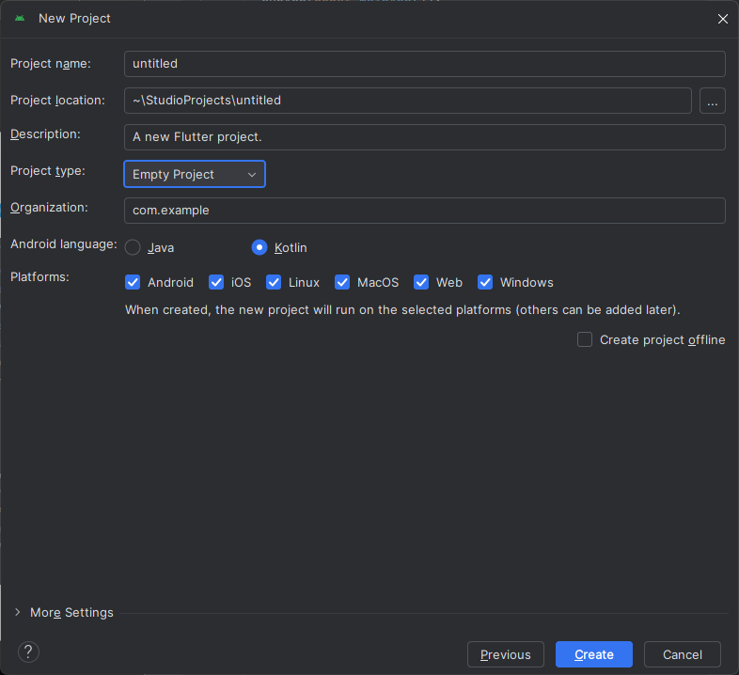
Creating a Flutter App Using Widgets (1/5)
Create empty Flutter project
New Project – Change project type to “Empty project”
TMA3084 (G01) 2025/2026-1

Slide 43
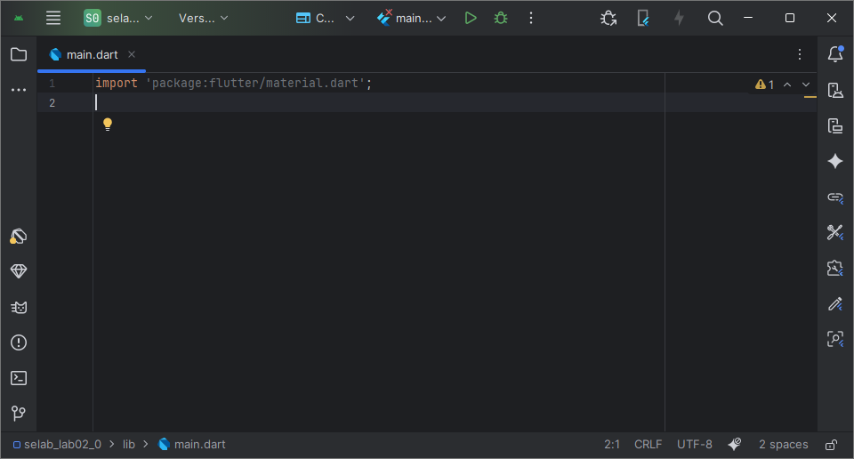
Creating a Flutter App Using Widgets (2/5)
main.dart – Delete all code except first line
TMA3084 (G01) 2025/2026-1

Slide 44
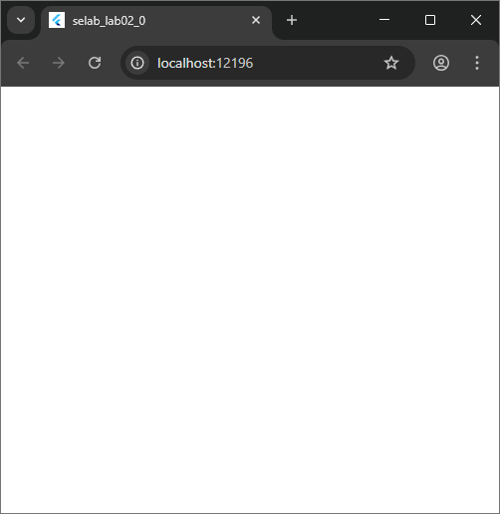
Creating a Flutter App Using Widgets (3/5)
Add the following code:
Run (SHIFT + F10)
import 'package:flutter/material.dart';
void main() {
Text('Hello, world!');
}
TMA3084 (G01) 2025/2026-1

Slide 45
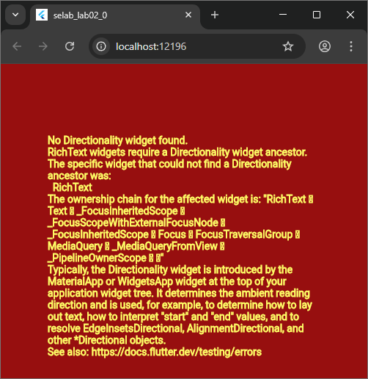
Creating a Flutter App Using Widgets (4/5)
Add the following code:
Run (SHIFT + F10)
import 'package:flutter/material.dart';
void main() {
runApp(Text('Hello, world!'));
}
TMA3084 (G01) 2025/2026-1

Slide 46
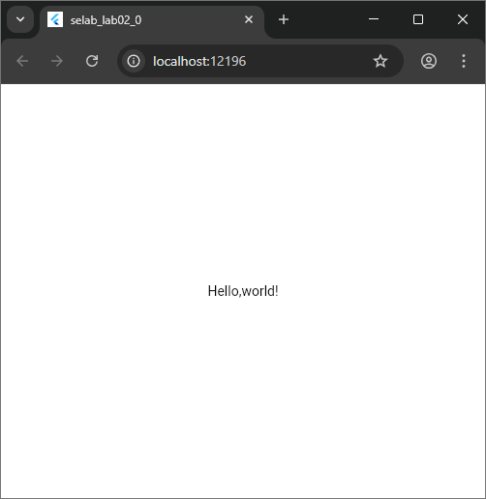
Creating a Flutter App Using Widgets (5/5)
Add the following code:
Run (SHIFT + F10)
import 'package:flutter/material.dart';
void main() {
runApp(Center(child: Text('Hello,world!', textDirection: TextDirection.ltr)));
}
TMA3084 (G01) 2025/2026-1

Slide 47
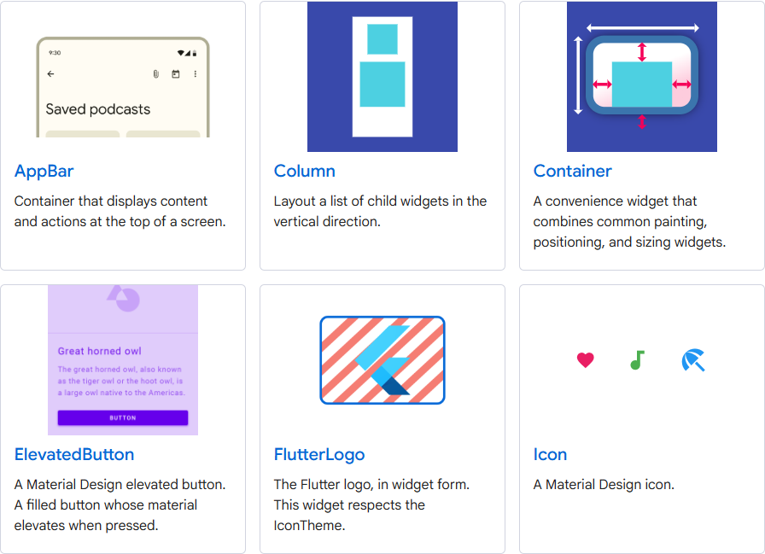
What is a MaterialApp widget? (1/3)
Starting point of your app
tells Flutter that to use Material components widgets and will follow a Material design
wraps commonly required for material design applications
  Scaffold, AppBar, Bottom navigation bars, Column, Row, Logo, Icon, Image, Raised Button, Text, and other widgets
TMA3084 (G01) 2025/2026-1

Slide 48
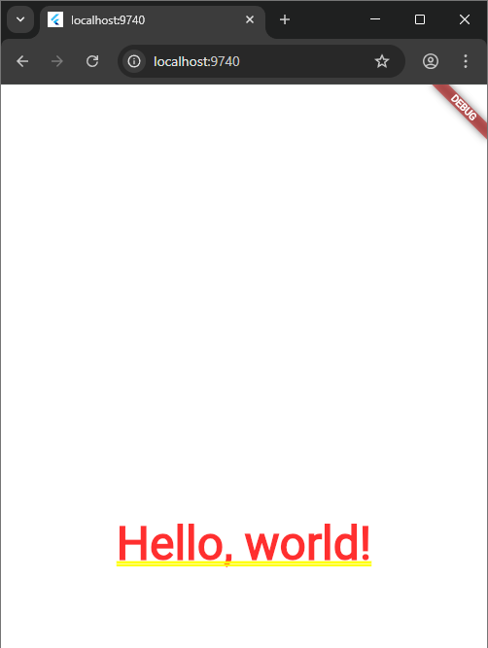
What is a MaterialApp widget? (2/3)
import 'package:flutter/material.dart';
void main() {
runApp(
MaterialApp(
home: Center(
child: Text('Hello, world!', textDirection: TextDirection.ltr),
),
),
);
}
TMA3084 (G01) 2025/2026-1

Slide 49
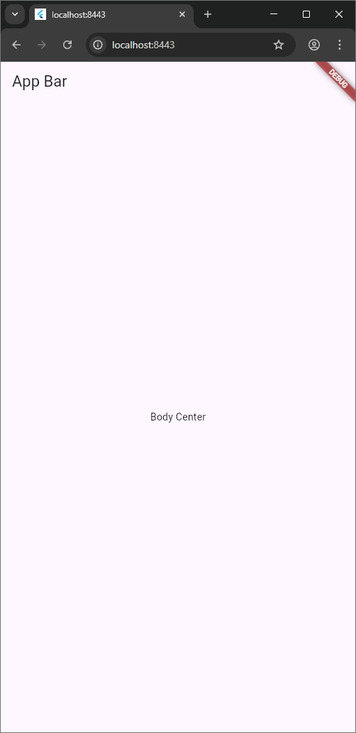
What is a MaterialApp widget? (3/3)
import 'package:flutter/material.dart';
class HomeScreen extends StatelessWidget {
const HomeScreen({super.key});
@override
Widget build(BuildContext context) {
return MaterialApp(
home: Scaffold(
appBar: AppBar(title: Text('App Bar')),
body: Center(child: Text('Body Center')),
),
);
}
}
void main() {
runApp(HomeScreen());
}
TMA3084 (G01) 2025/2026-1

Slide 50
Thanks!
Any questions?
TMA3084 (G01) 2025/2026-1

